Slide 1
Modelleren en Systeemontwerp
Creation design patterns: Singleton & object pool

Slide 2

This lecture
How to create objects
The Singleton Pattern
The Object Pool Pattern

Slide 3
Categories of design patterns
The Gang of Four distinguish three categories of design patterns:
Behavioral patterns characterize the way in which classes or objects interact or distribute responsibility.
Observer, Strategy
Structural patterns deal with the composition of classes or objects.
Adapter, Bridge, Decorator
Creational patterns are concerned with the creation of new objects.
Abstract Factory

Slide 4
Why worry about creation?
A lot of the design we have focussed on so far in this course is concerned with figuring out how classes should work together, and how to encapsulate variation – hiding implementation details
But if we hide implementation details behind an abstract class, who decides which concrete instances should be made?

Slide 5
Factories
Separating creation and usage leads to stronger cohesion
Separate two distinct tasks:
Defining classes and how they work together
Writing factories that instantiate the correct objects for the right situation

Slide 6
Not everyone agrees…
Remember Larman’s Creator GRASP principle:
Assign class A the responsibility to create instances of a classB if A has a B object
This is a good guideline for simple situations, provided you are not programming to an interface
If you are, you may need to consider applying creational design patterns

Slide 7
Creation vs use
Shalloway and Trott say that an object should either:
make and/or manage other objects
or it should use other objects
It should never do both
Following this rule leads to looser coupling

Slide 8

“Using objects”
”Program to an interface, not to an implementation”
”Find what varies, and encapsulate it”

Slide 9
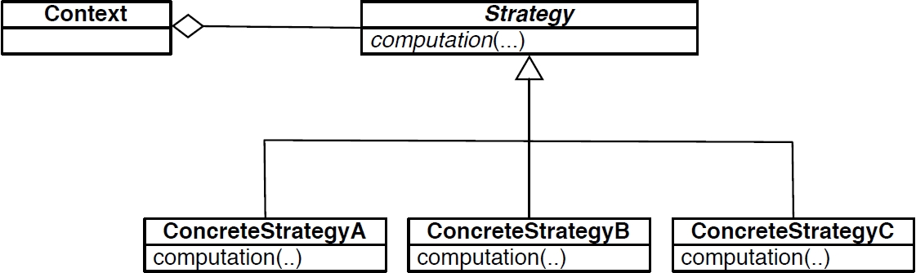
Example: strategy
If the Context creates concrete strategies, it is breaking an abstraction barrier
Instead, we want to assign the responsibility for creation to another object

Slide 10
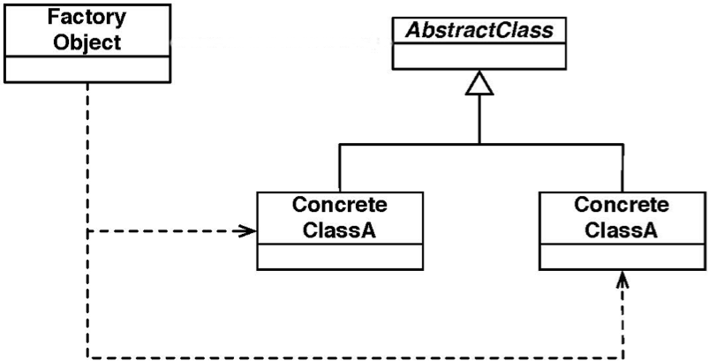
Factory objects
Compare figure 20-3 on page 352 of S&T

Slide 11
Using vs creating objects
The Factory can create values of type AbstractClass on request; it stores all the creational logic and creates a concrete object
Using objects means knowing only about the interface, not the implementation
The Factory objects should only know how to create concrete instances; they should not rely on the details of the abstract class/interface
We are free to add new concrete classes as necessary – we know that the client objects should never inspect which concrete class they are using – the Open-Closed principle!

Slide 12
Summary
Patterns add indirection (hide information behind an abstract class, move functionality to new classes, . . . )
This makes code more maintainable, but adds complexity, in case the client code must know about these constructions
Factories and other creational patterns are designed to hide the complexity that patterns sometimes introduce

Slide 13
The singleton pattern
Factories can be used for more than just controlling which concrete instances to create
For instance, factories may implement constraints
The Singleton Pattern for example, can be used to guarantee that exactly one object exists of a particular type

Slide 14
The singleton pattern

Slide 15
The singleton pattern
public static class Singleton {
private static Singleton instance;
private Singleton() { ... }
public static Singleton getInstance() {
if (instance == null) {
instance = new Singleton();
}
return instance;
}
}

Slide 16
Singleton: examples
Generally, singletons are used for objects that are shared within an entire application and that you need only one of:
Event managers
Texture managers
Logging service

Slide 17
Caution!
Singletons are not thread safe
If you have multiple threads trying to create a singleton at the same time, you may create two (or more) Singleton objects
Solution: The Double-Checked Locking Pattern addresses this, but we will not cover it in this course

Slide 18
More caution!
Singletons are a controversial pattern
The Singleton is regarded to be an ‘over applied’ pattern - it is often not even needed
To decide whether a class is truly a singleton, you must ask yourself some questions (Rainsberger 2001):
Will every application use this class exactly the same way?
Will every application ever need only one instance of this class?

Slide 19
Case study: electronic banking
Today let’s suppose we need to write software for online investment services, like alex.nl, that allow users:
to browse their investment portfolio
to give orders for purchasing or selling stocks
...
We will see that Factory tasks may be a bit more involving than just creating objects!

Slide 20
Architecture

Slide 21
Requirements
The only way to communicate with the mainframe is through TCP/IP connections using a custom messaging protocol
The C++ (or C#, or ...) middleware is responsible for verifying user orders, before they are executed by the mainframe

Slide 22
Example interaction
User logs in through their webbrowser
Middleware gets user ID and password; it reformats message in a format the mainframe can understand
Mainframe accepts the request and responds accordingly

Slide 23
Performance concerns
The middleware needs to handle requests from many, many people at the same time
We should aim at handling as many transactions as possible - maximizing throughput - and not worry about the time a single transaction needs

Slide 24
Design question
How many TCP/IP connections should I use?
1 is too little – all traffic goes over a single connection
100 is too much – the bandwidth available could not handle more than 20
This is a high-risk issue; the performance of the entire system can rely on it

Slide 25
Issues involved
Establish a single, robust TCP/IP connection
Determine the number of TCP/IP connections that are necessary
Establish a method to load balance the connections – we don’t want to route all traffic through a single connection, while the others are idle
What to do first?

Slide 26
Design choice
Start by establishing a single connection
In other words, start with a single responsibility, but don’t forget that you will have to address these other issues soon
Open-closed: insulate yourself from change, but anticipate new requirements
We need to design the system so that we can easily change the number of connections used
. . . but that is another responsibility

Slide 27
TCP/IP management
Distinguish separate responsibilities:
A Port class is responsible for communicating with the mainframe
A PortManager class is responsible for keeping track of the Ports

Slide 28
How many?
There should be multiple Port objects
The PortManager should be able to change the exact number easily
There should only be a single PortManager object – otherwise we don’t have control over how many connections are established exactly
So here we use the Singleton pattern!

Slide 29
Functionality
The PortManager supports has the following methods and attributes:
a private array of Port objects
GetInstanceOfPort() - which looks through the array to find an inactive port; if no port is inactive, it sleeps and retries
ReturnInstanceOfPort(Port release) - sets the status of the argument port to inactive

Slide 30
Using ports
Client code is now straightforward:
Ask the PortManager for a Port object
Complete the transaction
Release the Port to the PortManager
The client code does not need to know anything about how many ports are active, setting up connections, etc

Slide 31
Strong cohesion, loose coupling
This solution has strong cohesion and loose coupling – the Port, Client, and PortManager classes all have a clear set of responsibilities
What happens when I need to add error handling?

Slide 32
Adding error handling
What happens when a connection goes down?
The Client code needs to request another Port
The Port that went down should be closed
The PortHandler may want to establish a new connection to replace the Port that went down
It is clear who is responsible for handling this exceptional scenario

Slide 33
Are we done?
If you’re responsible for developing a system that handles millions of dollars worth of transactions, will you sleep easy at night?

Slide 34
Add checking
Maybe we would sleep easier if the PortManager also checked the integrity of the connection
Every 15 (or so) minutes it should:
Check how many unanswered requests there are for a Port
Query all the Ports to see if they are active or not
Check how many Ports have run into an error
If any of these checks produces unexpected results, warning bells should go off

Slide 35
Even better
Don’t stop there!
It’s not enough to know that a system is not failing
Perhaps you cannot detect connection problems, but people still are not able to use the website for other reasons
Log successful transactions

Slide 36
The object pool pattern
Note that getInstance() refers to the creation of a singleton ReusabePool

Slide 37
The object pool pattern: lessons
Factories are not just about instantiation!

